Slide 1
LECTURE # 03
Database Management System SE-208
The Relational Model
Course Instructor: Engr. Ruqqiya Asad
1
Notes:
1

Slide 2
Objectives
The Three-Level ANSI-SPARC Architecture
Database Languages
Data Models and Conceptual Modeling
Functions of a DBMS
2
Notes:
2

Slide 3
Brief History of the Relational Model
Proposed by E. F. Codd in 1970 at IBM
Published in the paper “A Relational Model of Data for Large Shared Data Banks”
Introduced the idea of storing data in the form of relations (tables)
Main goal: achieve data independence from physical storage
Introduced normalization to reduce redundancy and improve consistency
System R Project (IBM, USA)
Proved that the relational model is practical
Led to the development of SQL (Structured Query Language)
INGRES Project (University of California, Berkeley)
Developed a prototype RDBMS
Resulted in academic and commercial database systems
Peterlee Relational Test Vehicle (IBM UK)
Focused on theoretical issues like query processing and optimization
Late 1970s–1980s: commercial RDBMS
Examples: Oracle, DB2, SQL/DS, INGRES
Relational model became the standard model for database systems
Later, extensions were proposed:
Object-Oriented Databases
Semantic and Deductive Databases
3
Notes:
3

Slide 4
Relational Model Objectives
High degree of data independence (Programs not affected by changes in file structure, record order, or access paths)
Handling of data semantics, consistency, and redundancy (Introduction of normalized relations with no repeating groups)
Support for set-oriented data manipulation languages (Foundation for powerful query languages like SQL)
4
4
Notes:
4

Slide 5
Relational Data Structure
Relation: A relation is a table with columns and rows
Attribute: An attribute is a named column of a relation
Domain: A domain is the set of allowable values for one or more attributes.
Tuple: A tuple is a row of a relation
Degree: The degree of a relation is the number of attributes it contains.
Cardinality: The cardinality of a relation is the number of tuples it contains.
Relational database: A collection of normalized relations with distinct relation names.

Slide 6
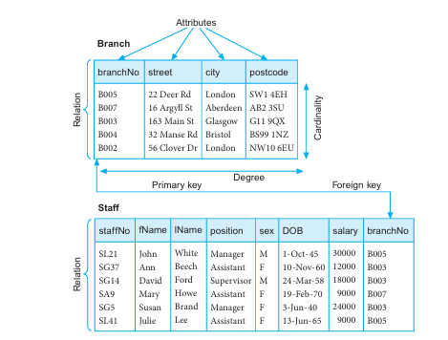
Instances of the Branch and Staff relations.

Slide 7
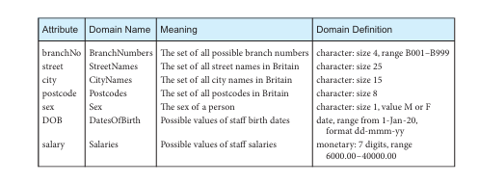
Domains for some attributes of the Branch and Staff relations

Slide 8
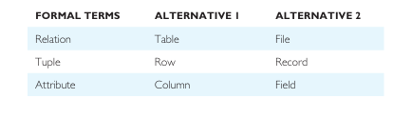
Alternative terminology for relational model terms

Slide 9
Mathematical Relations
A relation is based on the concept of sets and Cartesian product.
If D1 = {2, 4} and D2 = {1, 3, 5}, then D1 × D2 = {(2,1), (2,3), (2,5), (4,1), (4,3), (4,5)}
Any subset of a Cartesian product is called a relation. Example: R = {(2,1), (4,1)}
A relation can be defined using a condition: R = {(x, y) | x ∈ D1, y ∈ D2, y = 1}
Relations can also be defined by rules: Example: S = {(x, y) | x = 2y} → S = {(2,1)}
For three sets, relations are formed from ordered triples: D1 × D2 × D3 → {(d1, d2, d3)}
In general, for n sets: D1 × D2 × … × Dn = {(d1, d2, …, dn)}
Any subset of these n-tuples is an n-ary relation.

Slide 10
Database Relations
Relation schema: A named relation defined by a set of attribute and domain name pairs.
Let A1, A2, …, An be attributes with domains D1, D2, …, Dn
The set {A1:D1, A2:D2, …, An:Dn} is called a Relation Schema
A Relation (R) is a set of tuples (rows) that follow this schema
Each tuple has the form: (A1:d1, A2:d2, …, An:dn) where d1 ∈ D1, d2 ∈ D2, …, dn ∈ Dn
In table form:
Attributes → Column headings
Tuples → Rows
Example (Branch Relation):
A relation is a subset of the Cartesian product of attribute domains
Attributes: branchNo, street, city, postcode
One tuple: (B005, 22 Deer Rd, London, SW1 4EH)
A specific set of tuples at a time is called a Relation Instance
Table is just the physical representation of a mathematical relati

Slide 11
Relational database schema: A set of relation schemas, each with a distinct name. If R1 , R2 , . . . , Rn are a set of relation schemas, then we can write the relational database schema, or simply relational schema, R, as:
R = {R1 , R2 , . . . , Rn }

Slide 12
Properties of Relations
A relation has the following properties:
the relation has a name that is distinct from all other relation names in the relational schema;
each cell of the relation contains exactly one atomic (single) value;
each attribute has a distinct name;
the values of an attribute are all from the same domain;
each tuple is distinct; there are no duplicate tuples;
the order of attributes has no significance;
the order of tuples has no significance, theoretically. (However, in practice, the order may affect the efficiency of accessing tuples.

Slide 13
Relational Keys
Super key: An attribute, or set of attributes, that uniquely id
Candidate key: A super key such that no proper subset is a super key within the relation.
A candidate key K for a relation R has two properties:
Uniqueness. In each tuple of R, the values of K uniquely identify that tuple.
Irreducibility. No proper subset of K has the uniqueness property. There may be several candidate keys for a relation. When a key consists of more than one attribute, we call it a composite key.

Slide 14
Relational Keys
Primary key: The candidate key that is selected to identify tuples uniquely within the relation.
The candidate keys that are not selected to be the primary key are called alternate keys.
Foreign key: An attribute, or set of attributes, within one relation that matches the candidate key of some (possibly the same) relation.

Slide 15
Representing Relational Database Schemas
A relational database consists of any number of normalized relations. The relational schema for part of the DreamHome case study is:
Branch (branchNo, street, city, postcode)
Staff (staffNo, fName, IName, position, sex, DOB, salary, branchNo)
PropertyForRent (propertyNo, street, city, postcode, type, rooms, rent, ownerNo, staffNo, branchNo)
Client (clientNo, fName, IName, telNo, prefType, maxRent, eMail)
PrivateOwner (ownerNo, fName, IName, address, telNo, eMail, password)
Viewing (clientNo, propertyNo, viewDate, comment)
Registration (clientNo, branchNo, staffNo, dateJoined)

Slide 16
Integrity Constraints
Null: Represents a value for an attribute that is currently unknown or is not applicable for this tuple
Entity integrity: In a base relation, no attribute of a primary key can be null
Referential integrity: If a foreign key exists in a relation, either the foreign key value must match a candidate key value of some tuple in its home relation or the foreign key value must be wholly null.
General constraints: Additional rules specified by the users or database administrators

Slide 17
Views
Base relation: A named relation corresponding to an entity in the conceptual schema, whose tuples are physically stored in the database
View: The dynamic result of one or more relational operations operating on the base relations to produce another relation. A view is a virtual relation that does not necessarily exist in the database but can be produced upon request by a particular user, at the time of request.

Slide 18
Purpose of Views
Provide security by hiding sensitive attributes and tuples
Allow customized data access for different users
Simplify complex queries (e.g., joins shown as single tables)
Support the user’s external view of the database
Examples:
Show only manager details by joining Branch and Staff
Hide salary from some staff
Rename/reorder attributes (e.g., Branch Number instead of branchNo)
Show only properties managed by a specific staff member

Slide 19
Updating Views
Changes in base tables must appear in all related views
Updates on a view should also affect the base relation
But not all views are updatable
Rules:
Update allowed if view is based on single table and includes primary/candidate key
Update not allowed if view uses multiple tables (joins)
Update not allowed if view uses aggregation or GROUP BY
Types of Views:
Not updatable
Partially updatable
Fully updatable

